Slide 1
From Ghazni to Ghori to Sultanate rule
Divided India and it’s weakness

Slide 2
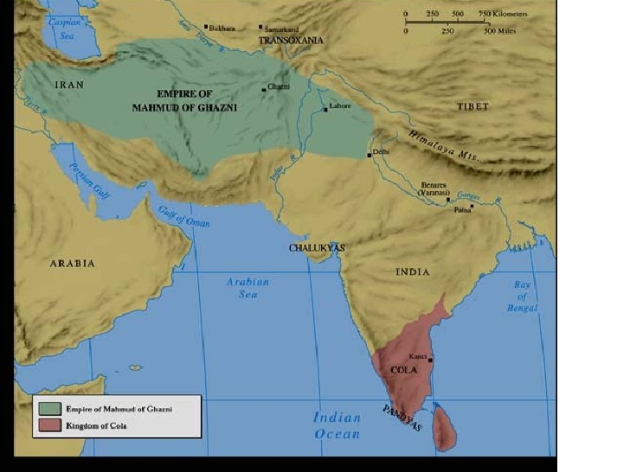
KINGDOM OF MAHMUD OF GHAZNI

Slide 3
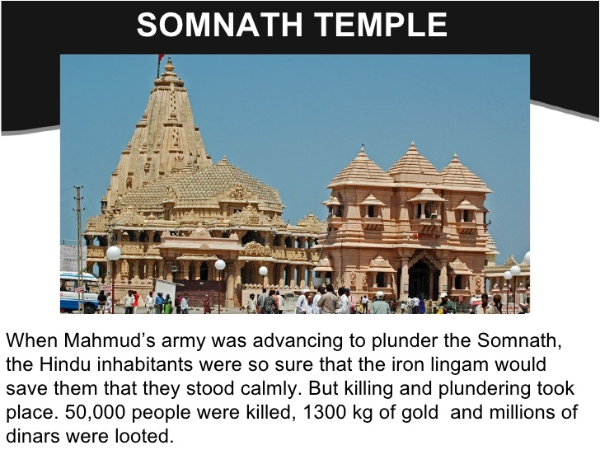
17 ATTACKS ON SOMNATH TEMPLE, GUJARAT

Slide 4
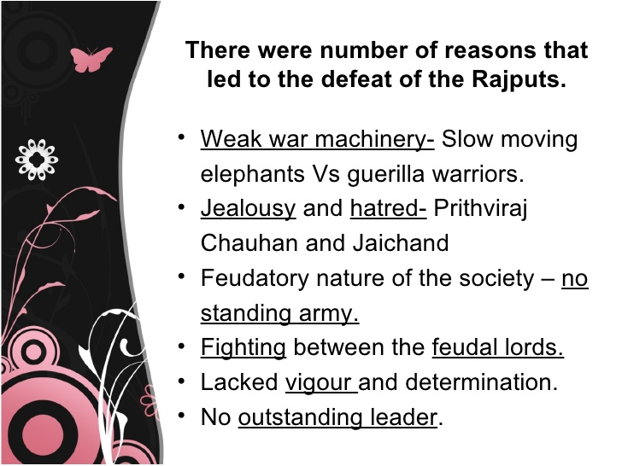
REASONS FOR INDIA’S DEFEAT

Slide 5
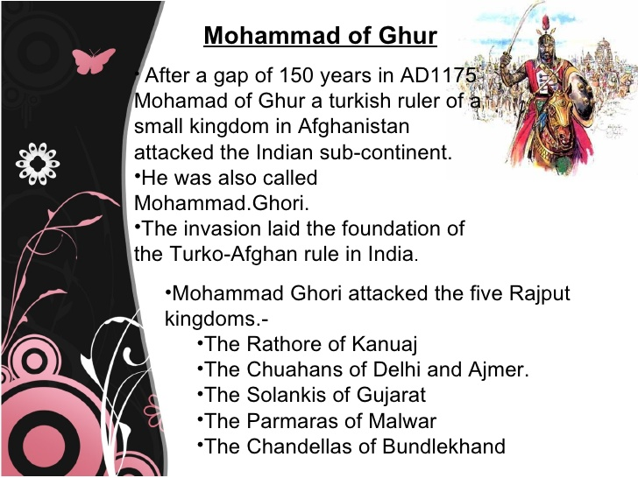
ADVENT OF MUHAMMAD GHORI

Slide 6
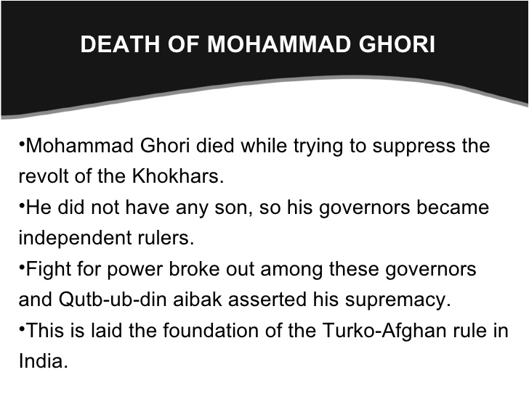
DEATH OF GHORI

Slide 7
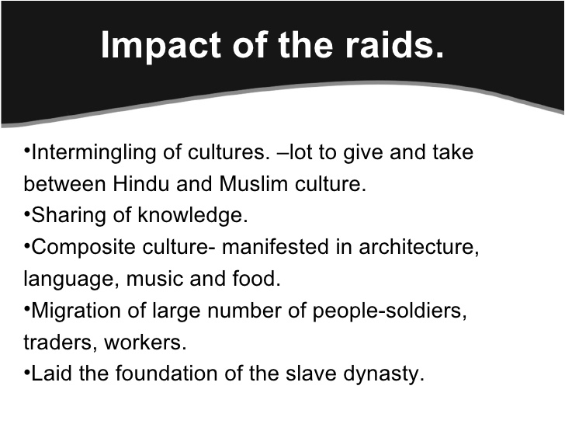
RESULT OF THESE ATTACKS

Slide 8
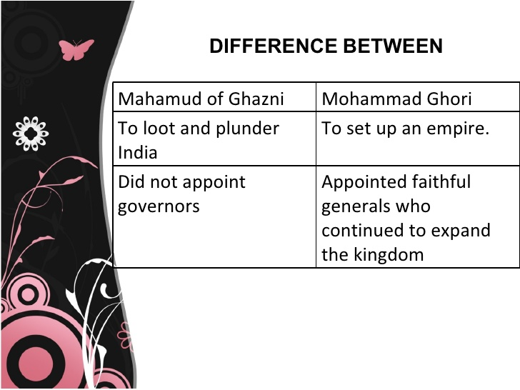
DIFFERENCE BETWEEN GHAZNI AND GHORI’S ATTACK

Slide 9
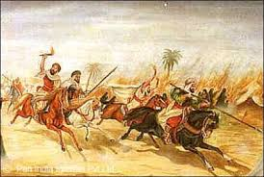
FIRST BATTLE OF TARAIN
It is true that Muhammad Ghori had become the master of the Punjab, Multan and Sindh, but he was far from being the Master of Hindustan. There were many wealthy and powerful Rajput Kingdoms in the heart of India. Prithvi Raj Chauhan or Raj Pithora, the Ruler of Delhi and Ajmer, decided to check the advance of Muhammad Ghori.
He marched against the Ghori chief at the head of a large army which, according to Firishta, included 2 lakh horses and 3,000 elephants. He was also helped by his fellow Rajput Princes. Jai Chandra, the Rathor Raja of Kanauj was the only Rajput Prince who kept aloof from the war as Prithvi Raj had insulted him by carrying awahy his daughter by force.
The armies met at Tarain, a village 14 miles away from Thanesar in 1191 A.D. Muhammad Ghori followed the tactics of the right, left and centre and himself occupied a position in the middle of his army. The Rajputs attacked both the wings of the Muslim army which was scattered in all directions. Muhammad Ghori attacked Govind Raj, the brother of Prithvi Raj, on the mouth with his sword and knocked out his teeth.
Govind Raj returned the blow and struck Muhammad Ghori in the arm and gave a severe wound. Stunned by his blow, Muhammad Ghori turned back and began to bleed. His strength was exhausted and he was about to fall down from his horse. However, a Khilji soldier helped Muhammad Ghori and carried him off the field of battle. The Muslim army dispersed in all directions. It was pursued for 40 miles and after that the chase was given up Muhammad Ghori went back to Ghazni. The Rajputs besieged Sarhind but were not able to capture it easily.

Slide 10
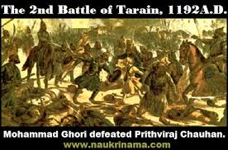
Second battle of Tarain
Second Battle of Tarain (1192) :
When Muhammad Ghori reached Gazni, he punished all those officers and soldiers who had run away from the battle-field. They were publicly disgraced and paraded in the city. It is stated that after the first battle of Tarain in 1191 A.D., Muhammad Ghori "never slumbered in ease nor waked but in sorrow and anxiety".
In 1192 A.D., he marched from Ghazni at the head of a large army consisting of 1, 20,000 men. He encamped once again near Tarain. There was a bloody battle. As many as 150 Rajput Princes fought on the side of Prithvi Raj. To begin with, the Hindu cavalry was able to check the advance of the Muslims. The battle continued from morning till sun-set. However, towards the end, Muhammad Ghori with the help of 12,000 horsemen made a desperate charge and "carried death and destruction throughout the Hindu Camp." The Rajputs were not able to stand the charge and were defeated.

